Slide 1
Describing Architecture
views

Slide 2
Alfred North Whitehead
By relieving the mind of all unnecessary work, a good notation sets it free to concentrate on more advanced problems, and in effect increases the mental power of the [human] race.

Slide 3
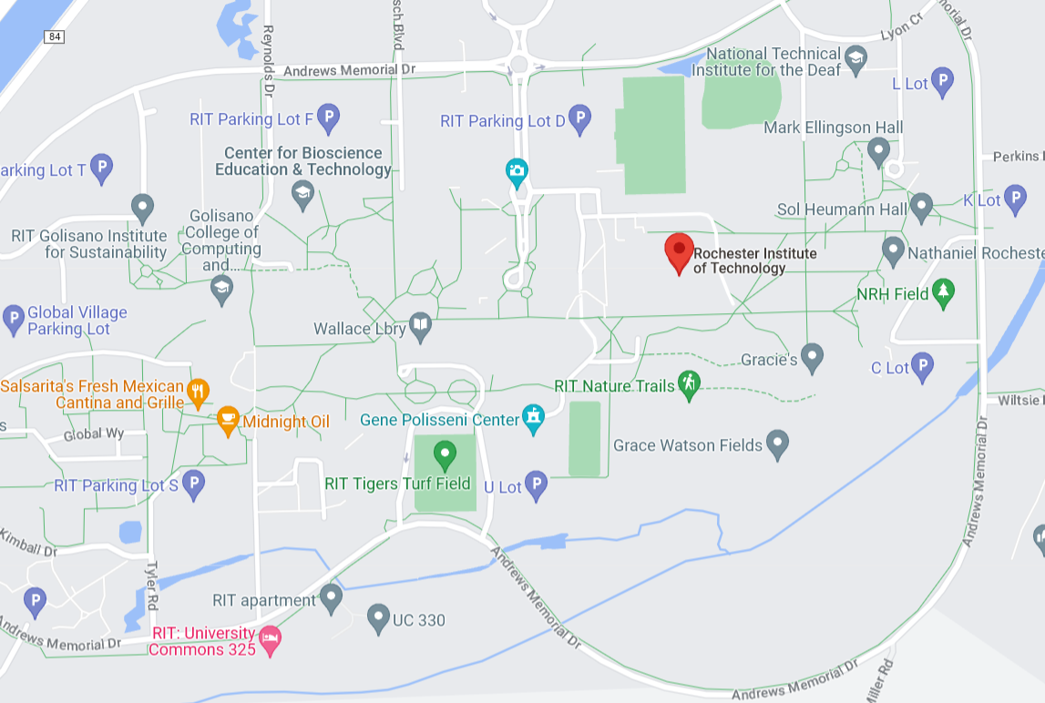
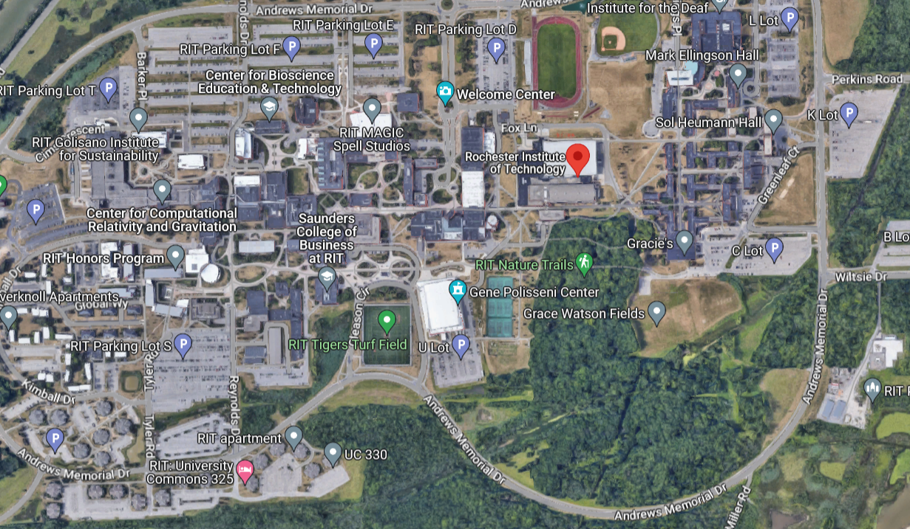
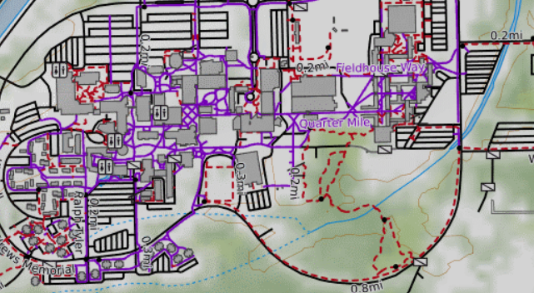
Views
  A representation of a set of software elements and the relationship among them
  Documenting an architecture is a matter of documenting the relevant views and then adding documentation that applies to more than one view

Slide 4
Types of Views
  System Diagram – Abstract description of the system whose requirements are being modeled
  Module View – Define the structure of the code base
  Component and Connector Views – Specify the structure and behavior of runtime elements in the system
  Allocation Views – The mapping of software units to elements of an environment
  Quality Views – A view created by extracting relevant pieces of structural views and packaging them together
  Behavior Views – Describe interactions between components while the system is a specific state

Slide 5
Which Views? The Ones You Need!
Different views support different goals and uses
The views you document depend on the stakeholders and uses of the documentation.
Each view has a cost and a benefit; the benefits of maintaining a view should outweigh its costs
At a minimum, at least on module view and one component and connector view

Slide 6
System Diagram
  Abstract Description of the system whose requirements are being modeled
Components of a System Diagram:
  Boundaries of the overall system
  Inputs to and outputs from the system
  Subsystems of the system
  Identification of the interfaces between the subsystems
  A System Diagram is a high-level model of the system.

Slide 7
Type of System Diagrams
System Diagrams are variable in their view of the system
A system diagram can show
- Components
- Interactions
- Boundaries
- …
Choose the type of information you want to convey AND what questions you are trying to answer
  Big blocks
  APIs
  Physical assets
  Data or communications
  …
Then select HOW you will show it
Components & Interactions tend to be the most common

Slide 8
Module Structure Views
Elements - modules, implementation units of software that provide a coherent set of responsibilities
  Class
  Collections of classes
  Layer
Relations
  Object oriented
    Is part of, a part/whole relationship
    Depends on, a dependency relationship between two modules
    Is a, a generalization/specialization relationship
  Layered – aggregation of modules into layers
Constraints
  May impose topological constraints – visibility – between modules
UML: Package and class diagrams

Slide 9
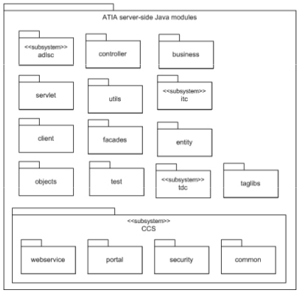
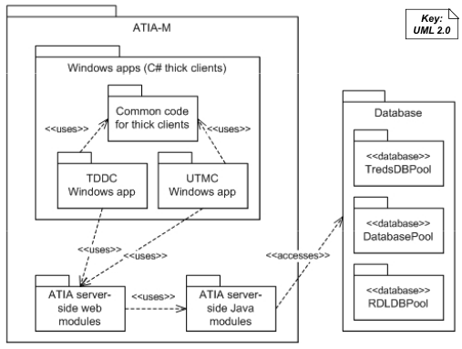
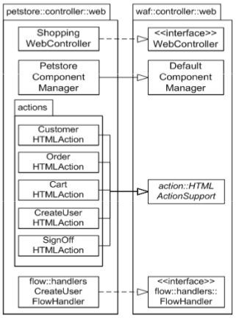
Module Views
Depends-on
Is-part-of
Is-a
Notes:
Blueprint for the construction of the code
Analysis of impacts of changes
Planning incremental development
Requirements tracability
Communicating functionality
Data model

Slide 10
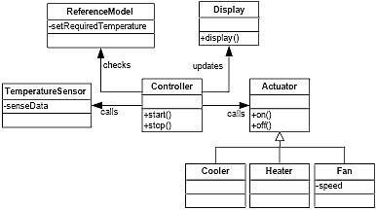
Module View Example
Climate control system in vehicles

Slide 11
Usage of Module Views
Static functional decomposition
System information architecture
Supports the definition of work assignments, development process and schedules
  Blueprint for coding and testing
  Change-impact analysis
  Requirements traceability analysis
“It is unlikely that the documentation of any software architecture can be complete without at least one module view.”

Slide 12
Component and Connector Views
Elements
  Components – principle processing units and data stores
  Connectors - pathways of interaction between components.
  Can be simple:
    Service invocation
    Asynchronous message queues
    Event multicast
    Pipes that represent asynchronous, order-preserving data streams
  Or Complex:
    Transaction-oriented communication channels
    Enterprise service bus that mediates interactions between collections of service users and providers

Slide 13
Component and Connector Views
Relations (in UML notation)
  Components have ports with associated connector roles
  Ports have associated interfaces
  Relations represented as a graph of components and connector attachments.
    E.g., client – server invoke-services role
  Interface delegation - component ports may be associated with one or more “internal” ports
UML: Class, Package, and/or Component diagrams

Slide 14
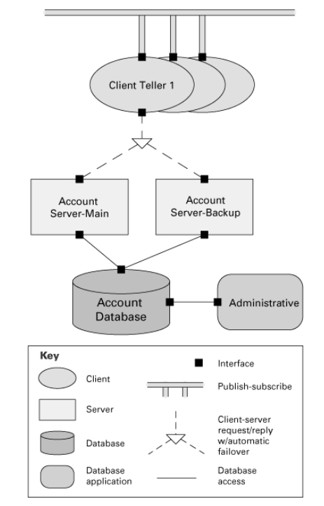
This system contains a shared repository that is accessed by servers and an administrative component. A set of client tellers can interact with the account servers and communicate among themselves through a publish-subscribe connector.
The publish-subscribe connector supports asynchronous event announcement and notification
Client-server connectors allow a set of concurrent clients to retrieve data synchronously via service requests.
The database access connector supports transactional, authenticated access for reading, writing, and monitoring the database
Documenting Software Architecture: Views and Beyond

Slide 15
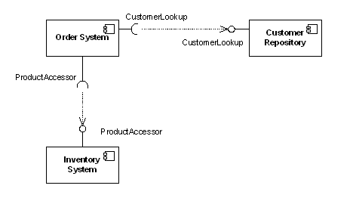
Component and Connector UML Notation
Provided interface
Required interface
Component
Port

Slide 16
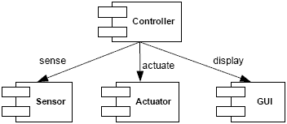
Component-and-Connector View Example
(Can show simplified relationships)

Slide 17
C & C Views
Constraints and Usage
Usage
  Major executing components
  Major shared data stores
  Runtime interaction; e.g., control and data flow, parallelism
  Connector mechanisms – e.g., service invocation, asynchronous messaging, event subscription, …
Constraints
  All attachments are only between components and connectors
  Attachments must be between compatible ports and roles

Slide 18
Allocation Views
Elements
  Software element
    Some runtime packaging of logical modules and components (e.g., processes)
  Environmental element - execution (hardware, runtime operation) or development (file structure, deployment, development organization)
    Properties that are provided to the software; e.g., bandwidth
Relations
  Allocated to - a software element is mapped (allocated to) an environmental element
  Static or dynamic (e.g., resource allocation)
UML: Deployment diagrams

Slide 19
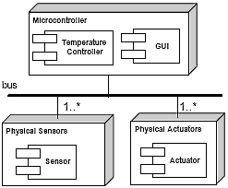
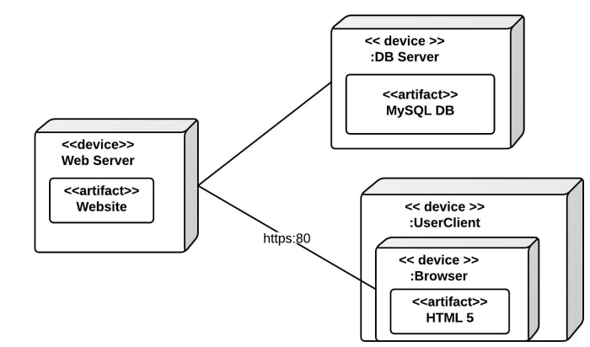
Allocation View Example

Slide 20
Usage of Allocation Views
Specify structure and behavior of runtime elements such as processes, objects, servers, data stores
Reasoning and decisions about …
  What hardware and software is needed
  Distributed development and allocation of work to teams.
  Builds, integration testing, version control
  System installation

Slide 21
Augment with “Quality” Views
More specific views may be needed for specific stakeholders or to address specific concerns
The solution may be cross cutting across multiple structural views
  By analogy – plumbing or electrical systems for buildings
A quality view extracts relevant pieces of structural views and packages them together
  E.g., show just those components that have a role in satisfying security requirements

Slide 22
Relating Structures to Each Other
Each structure provides a different perspective and design handle on a system
  Each is valid and useful on its own
The structures are not independent, just the opposite
  Elements of one will be related to elements of another
Relationships should be consistent and rational
Element names: meaningful and consistent across views!!

Slide 23
Relating Structures to Each Other
Example: a code module in a decomposition structure may map to one, part of one, or several run-time components in a component-and-connector structure
Sometimes, one structure dominates (usually decomposition structure)
For some systems, some structures may be irrelevant or trivial, such as a single node, single process application

Slide 24

Relating Structures to Each Other

Slide 25
Sequence Diagrams
Behavior Diagrams

Slide 26
Sequence Diagrams
The
classes
Client
Supplier
Client object
Supplier object
PerformResponsibility()
PerformAnotherResponsibility()
Object Lifeline
: Client
: Supplier
Reflexive message
(Message to self)
1. PerformResponsibility
1.1. PerformAnotherResponsibility
Message
Hierarchical message numbering
Focus of Control
(Activation)
Sequence diagrams illustrate how objects interact with each other dynamically

Slide 27
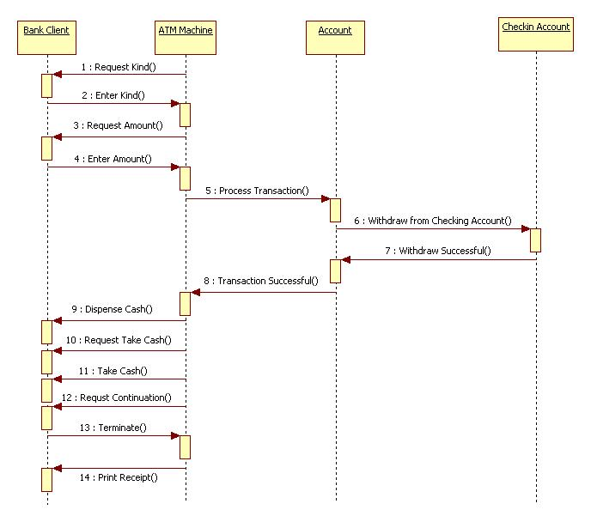
ATM Withdrawal

Slide 28
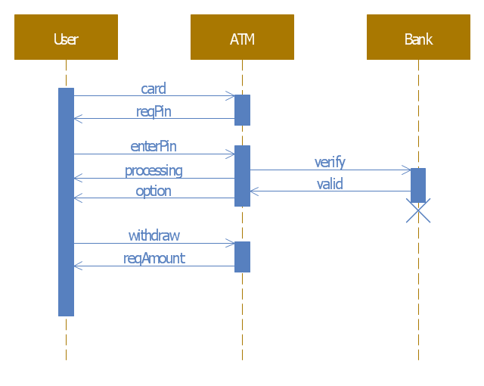
ATM Withdrawal (slightly different objects and style)

Slide 29
Supplemental Material
Examples of Views

Slide 30
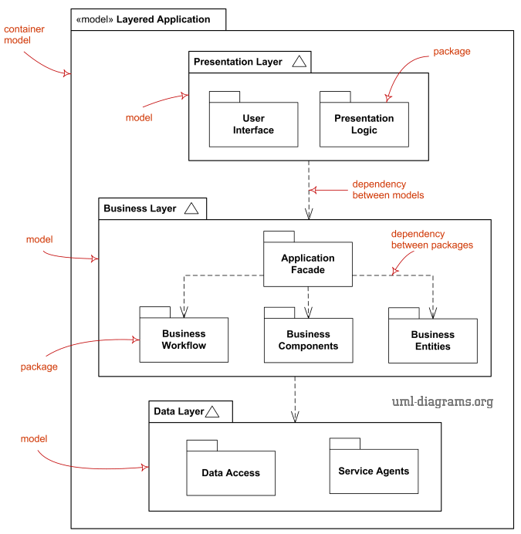
Module View Example
UML Module Diagram

Slide 31
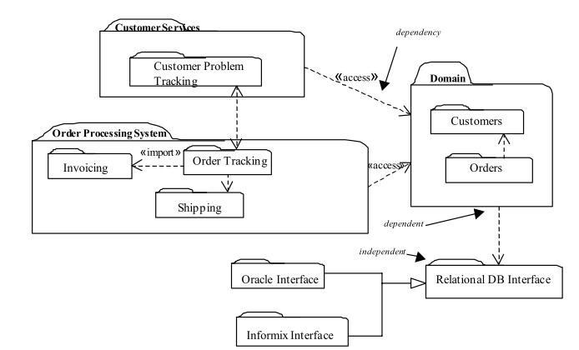
Module View Example

Slide 32
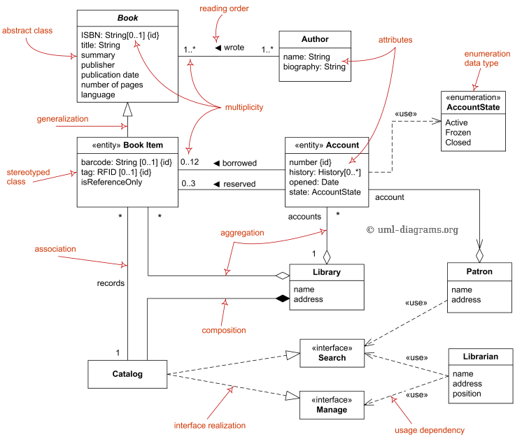
Module View Example
UML Domain Model Class Diagram

Slide 33
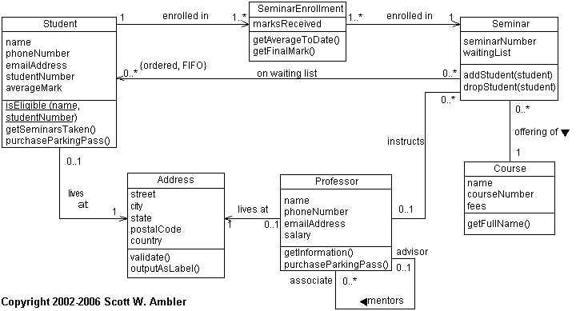
Module View Example
UML Class Diagram

Slide 34
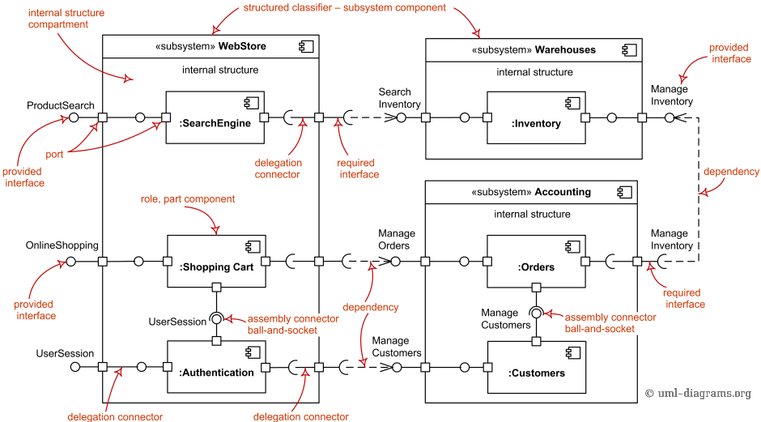
Component-and-Connector
UML Component Diagram

Slide 35
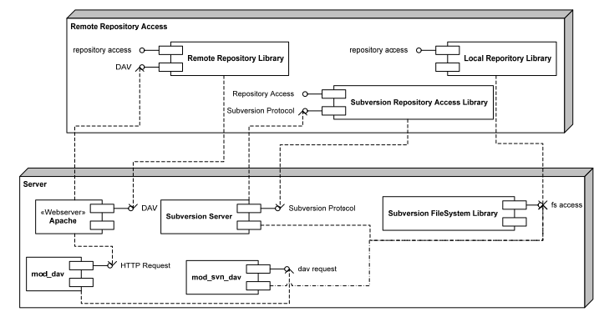
Component-and-Connector
Client Server View Example

Slide 36
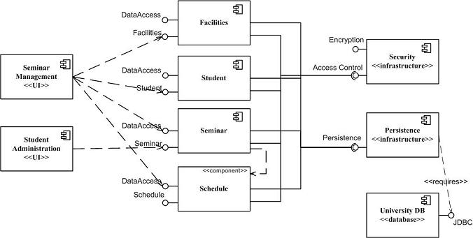
Component-and-Connector
Another Example

Slide 37
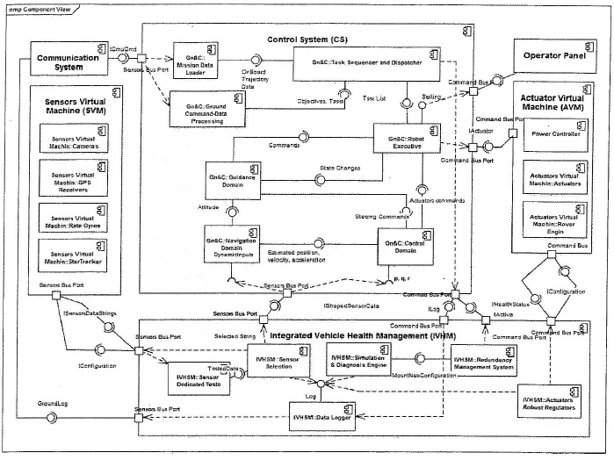
Component-Connector
Embedded Example

Slide 38
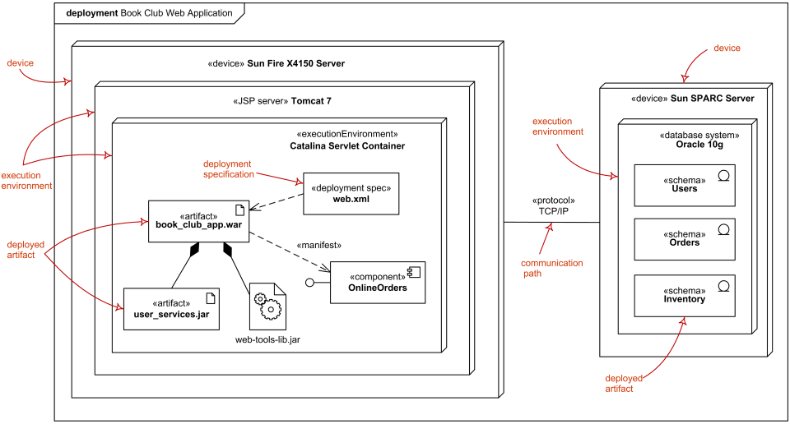
Allocation View
UML Deployment Diagram Example

Slide 39
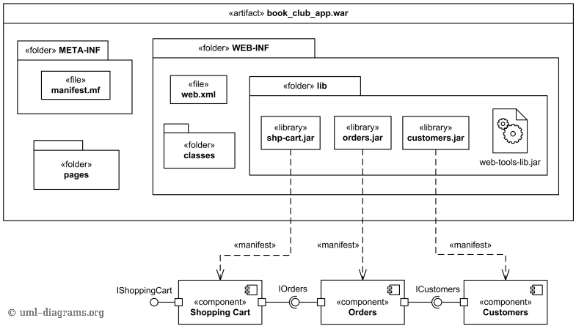
Allocation View
UML Implementation Diagram

